Slide 1

Khulna University of Engineering & Technology
Course: CSE 4208
Course Title: Computer Graphics Laboratory
3D BIGBEN
Presented by
Shrabanti Debnath
Roll: 1907094

Slide 2
Outline
Objectives
Introduction
Features
Conclusion

Slide 3
Objectives
To deepen understanding of OpenGL 3.3 and use it to create a dynamic 3D scene featuring the iconic structure, Big Ben.
To explore and implement camera controls, dynamic lighting, shading techniques, and realistic texturing.

Slide 4
Introduction
The project is a 3D visualization of the BigBen developed using OpenGL and C++.
Features are 3D model of the monument which also includes animated birds and water to make the scene dynamic.
Provides an interactive and visually appealing experience.

Slide 5
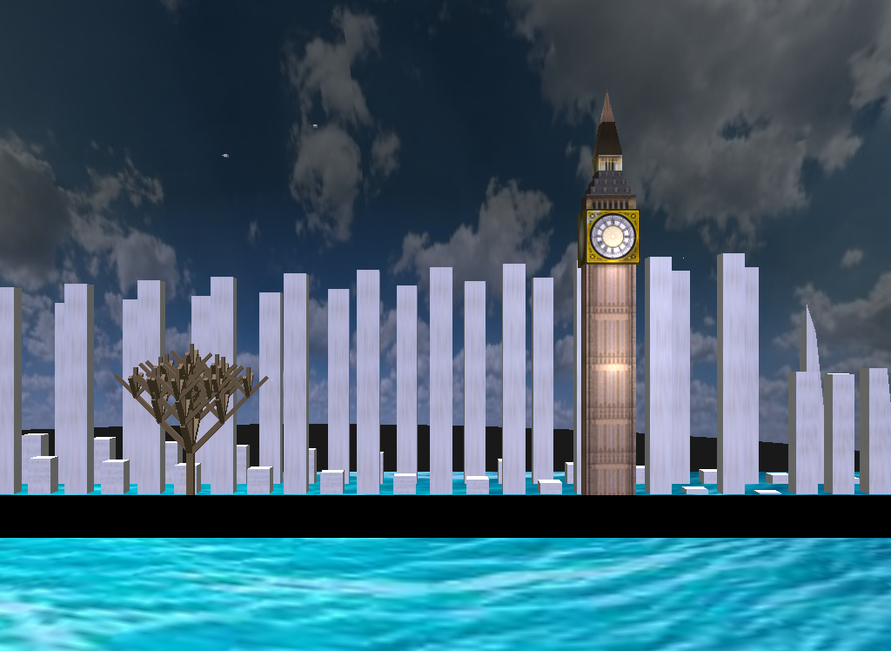
Features
Starting Scene
Fig 1 : Starting Scene

Slide 6
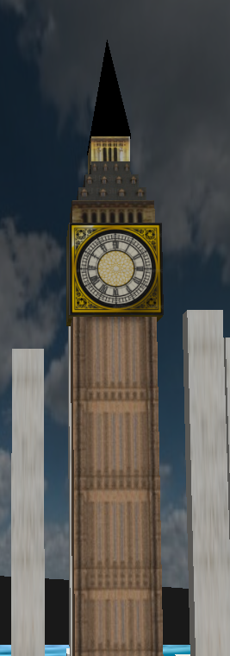
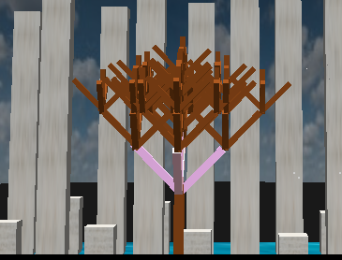
Features Cont’d
Bigben structure and fractal tree
Fig 2: Bigben structure and fractal tree

Slide 7
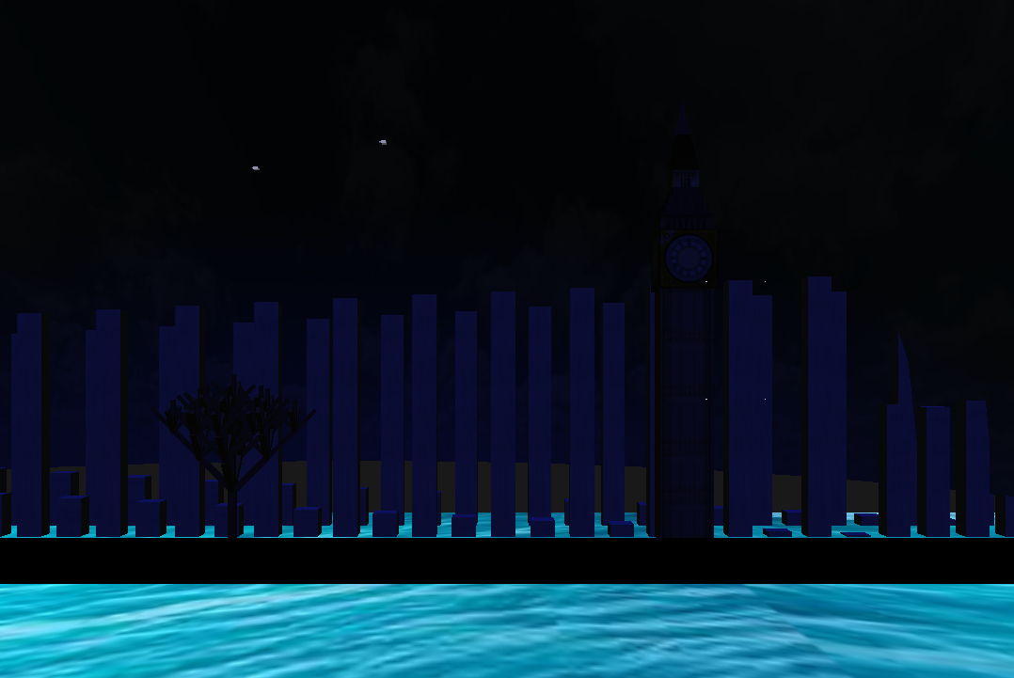
Features Cont’d
Moon-Night View (Press ‘M’)
Fig 3: Moon Night View

Slide 8
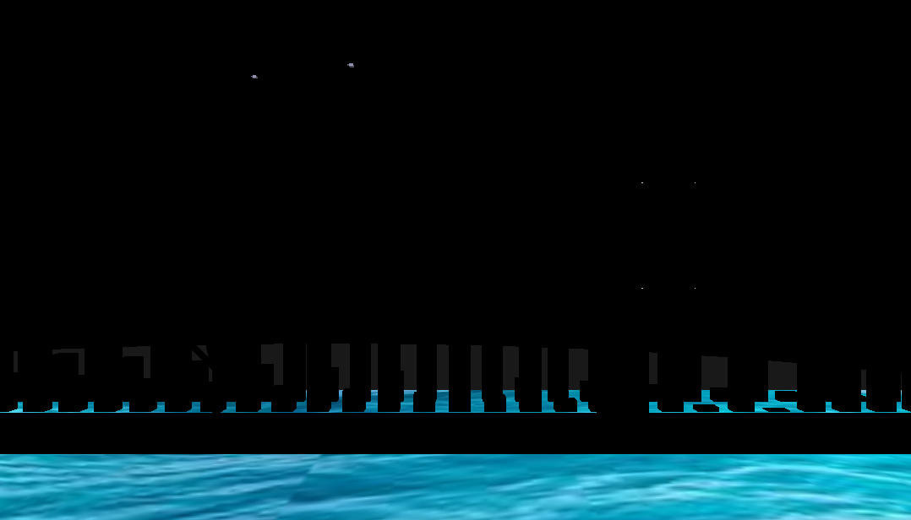
Features Cont’d
Night View (Press ‘N’)
Fig 4: Night View

Slide 9
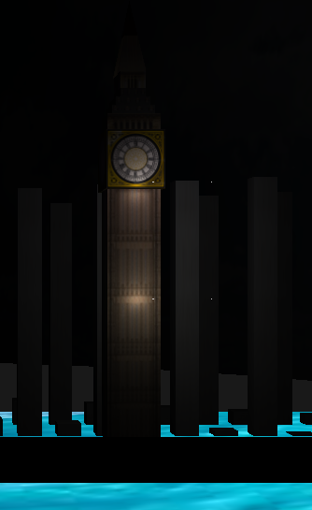
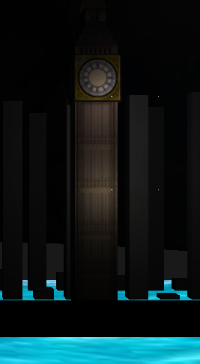
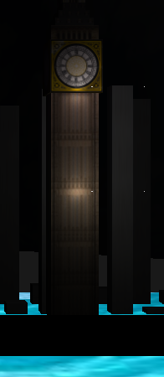
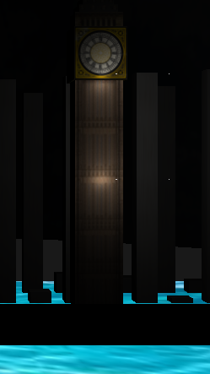
Features Cont’d
Specular,ambient,diffuse,point lights(press ‘2’, ‘4’, ‘3’, ‘1’) implementation:
Fig 5: Specular,ambient,diffuse,point lights

Slide 10
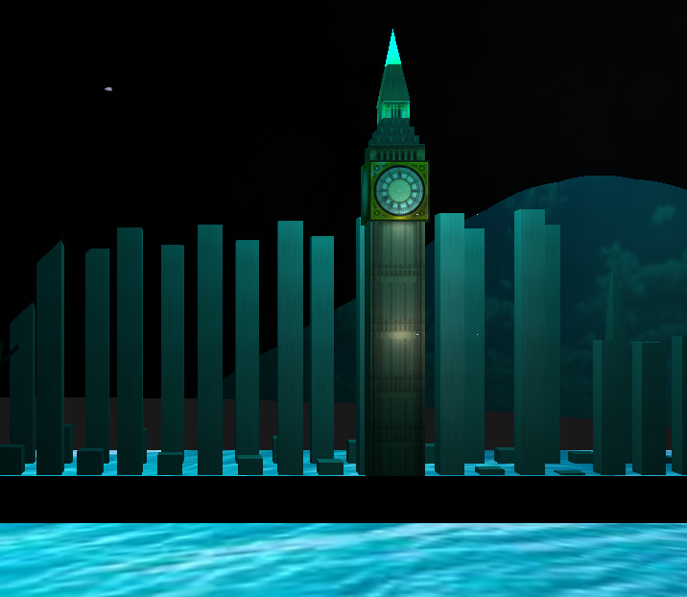
Features Cont’d
Spot light(Press ‘5’)
Fig 6: Spotlight

Slide 11
Conclusion
OpenGL 3.3 is a very powerful graphics library. This project was built using only the basic structures. But using Blender or any other 3D modeling software it can improved.
We can also add sound to the project.

Slide 12
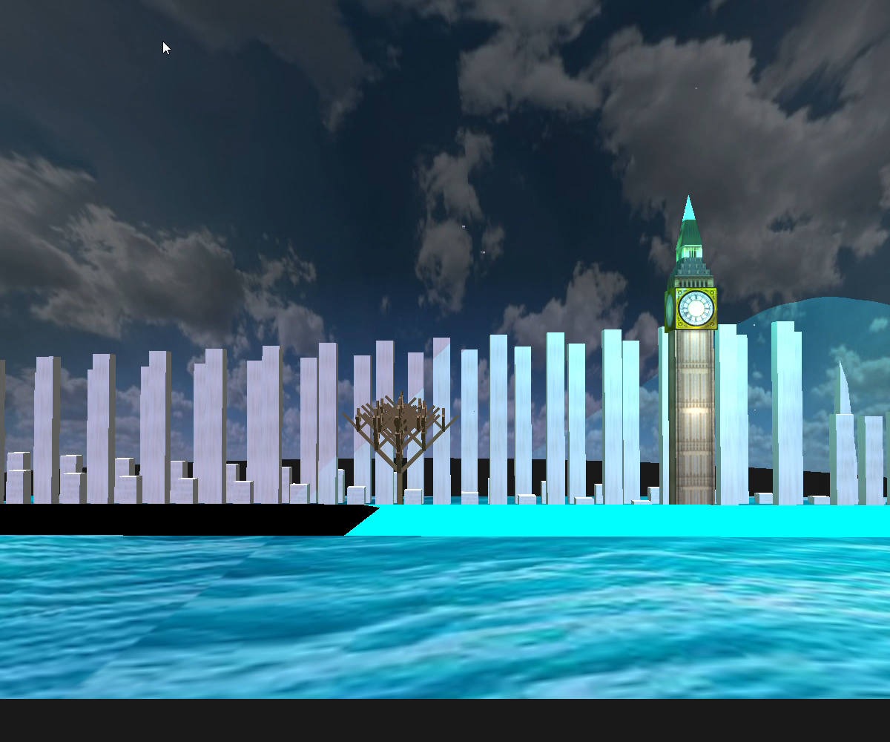
Visual Representation of the Project

Slide 13
THANK YOU

